Slide 1
Team VLISSIDES
Regan Fencl, Robert Holliday, Justin Stevenson

Slide 2
Our scenario
The scenario for our game will be set in a deep dark cave with a red dragon who is the keeper of the cave. The dragon is watcher of the large stash of gold and precious jewels. The point of the game will be for the party to traverse the cave. In the cave there are cave monsters, and minions of the dragon. The monsters are under the dragons command to keep outsiders from getting the stash of goods that are in the cave. The party, the good guys, must battle with, the bad guys, the monsters loosing life and mana for the goal of defeating the dragon and obtaining the reward of the stash of gold and the jewels.

Slide 3
Our High level design
Based on Model, View, Controller.
Controller is the Game class. It mediates data between the view and the model.
It is also a façade, in that it provides a simplistic interface to the game.
The model is our character, dungeon, and battle systems.

Slide 4
Dungeon System
Manages the grid where the players and enemies interact.
Knows where the player is at in the grid.
The grid can be static or dynamic.
Does not allow the players to move outside of the grid or through a wall.
It decides when a battle occurs either via randomness or reaching set tiles, such as the dragon tile.
Tiles can have items, represent by a chest, that the player can get into their inventory.
Tiles can also be a freespace, or a wall as well.

Slide 5
Character System
Character is an abstract class. It holds data and methods that both enemy characters as well as player character need for a battle.
AbilitiesHolder is an abstract class because both players and enemies have abilities, however they are used in different ways. Players get their abilities from leveling, while enemies just get them handed to them. Players use those abilities via input. Enemies use their abilities via algorithms.
There is an AbilityIterator that goes through the abilities and allows access to a specific ones.

Slide 6
Battle System
Handles logic and events in a battle.
Turn-based.
Get good and bad guys.
Create an array that can hold all characters.
Sort array by agility.
Loop through array, giving each character a turn. Start over at the first element you the last goes.
For each players turn, MATH and handle choices.
Uses strategy pattern to handle what occurs in battle.

Slide 7
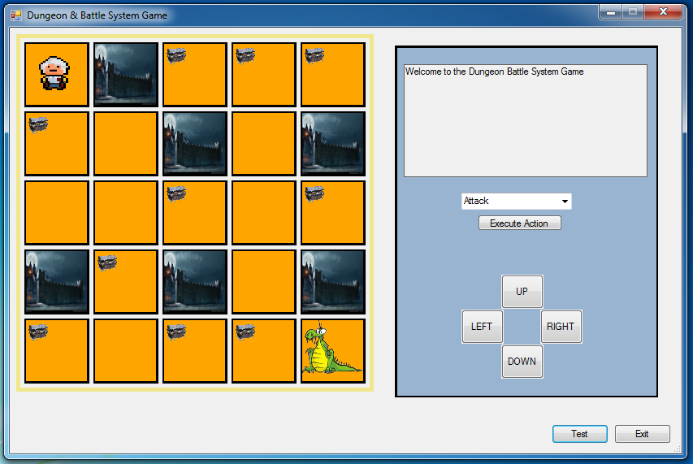
Graphical user interface
Displays the game board grid, and has text output.
Has graphical display of:
Freespaces
Walls
Items, e.g, treasure.
Uses buttons to navigate the game.
UP, DOWN, RIGHT, LEFT.
Drop down menu to execute actions.

Slide 8
GUI Issues
Simple conversion from console to GUI?
No. There were issues with presenting text, a question, and waiting to get the response. The issue with presenting the text in the textbox, then prompting the user to answer the question, required that the thead that presented the question block and then spawn a new thread to get the answer , similar to Console.ReadLine(), then give the value to the thread, then on to the next question/answer processing.
This would require the whole system to be redesigned to work with the GUI, so we just stayed with the console input.
Assumed that getting the GUI to work would be easy.
Tried using an ArrayList to hold the questions, and display them after each time the submit button was pressed, but was not synchronized with the method that was needed the input.
Multithreading

